Slide 1

Boston Crash
ALY – 6040(80476) – Spring 2023
Group 2
Aditi Rajmane – rajmane.a@northeastern.edu
Avi Jani – jani.av@northeastern.edu
Ayushi Ajay Walia – walia.ay@northeastern.edu
Pranjal Shah – shah.pranj@northeastern.edu
Professor – Kasun Samarasinghe

Slide 2
Introduction
The Massachusetts crash data is a comprehensive dataset that provides valuable insights into the factors contributing to motor vehicle crashes in the state.
It contains detailed information about each crash, including vehicle types, road and weather conditions, and contributing factors (e.g., driver distraction, speeding, impaired driving).
This dataset enables us to identify patterns, trends, and underlying causes of crashes, ultimately helping to improve road safety.
This dataset has approximately 45980 entries.

Slide 3
Why this dataset is selected?
The Massachusetts crash data is particularly relevant for policymakers and researchers in traffic safety.
Policymakers can use the data to evaluate the effectiveness of existing interventions and policies, making informed decisions on resource allocation and potential policy changes.
Researchers can analyze the data to assess the impact of interventions, identify best practices, and contribute to evidence-based strategies for enhancing road safety.

Slide 4
Exploratory Data Analysis
Performing Linear and Logistic Regression
Hyperparameter tuning using LightGBM
CatBoost
XGBoost for 2 Variables

Slide 5
Linear and Logistic Regression
Linear regression model accurately predicted the number of vehicles involved in each crash.
Logistic regression model requires more precision for predicting the number of vehicles involved.
These results suggest that linear regression may be better for this problem.
Further analysis and experimentation are needed to understand each model's strengths and weaknesses fully.
Determining the best approach for predicting the number of vehicles involved in car crashes requires additional investigation.
Additional research can help identify the optimal model and improve prediction accuracy.
Understanding the limitations and nuances of each model is crucial for making informed decisions in crash prediction.

Slide 6
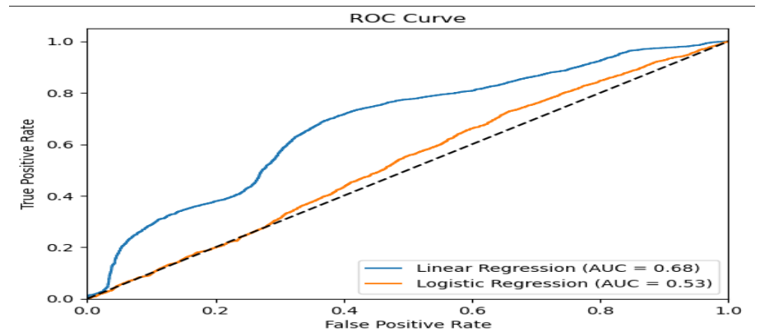
ROC curve for Linear Regression
Linear Regression model (blue line) has an AUC of 0.68, indicating moderate performance in classifying positive and negative instances.
Logistic Regression model (orange line) has a lower AUC of 0.53, performing poorly in distinguishing between positive and negative classes.
Logistic Regression model quickly reaches a plateau, showing limited performance.
Overall, the ROC curve confirms the Linear Regression model’s superiority over the Logistic Regression model in this classification task.

Slide 7
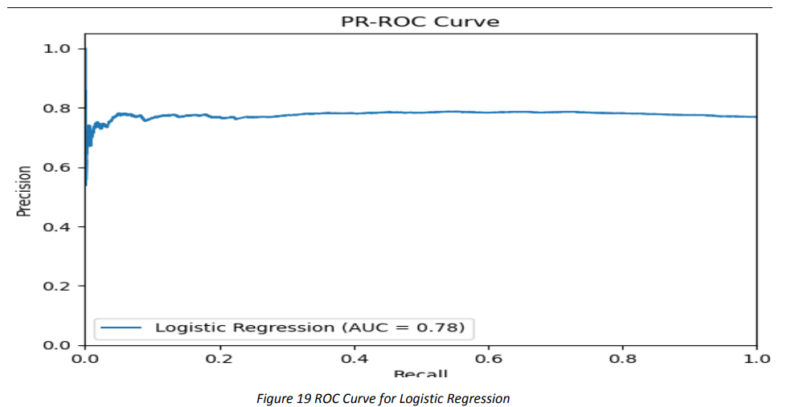
ROC curve for Logistic Regression
PR-ROC curve measures the model's ability to identify positive instances while minimizing false positives.
Logistic regression model achieves an AUC of 0.78, indicating good performance.
Higher AUC suggests effective identification of positive instances with high precision.
Logistic regression model is well-suited for this dataset based on its AUC score.
PR-ROC curve provides valuable insights into model performance for the classification task.

Slide 8
Hyperparameter Tuning using LightGBM
The Analysis demonstrates hyperparameter tuning using LightGBM for binary classification.
Data is split into training and testing sets.
Hyperparameter grid is defined to specify tuning options.
LightGBM classifier is created and trained using grid search cross-validation.
Best hyperparameters found: learning rate=0.1, max depth=7, estimators=50, leaves=127.
Training set accuracy: 0.9785, indicating good performance.
Model is evaluated on the testing set, achieving the accuracy of 0.9797.
LightGBM is a powerful tool for classification tasks and demonstrates the potential for improving accuracy.
This Analysis showcases a practical approach to hyperparameter tuning and highlights LightGBM's capabilities.

Slide 9
CatBoost
This Analysis utilizes the roc_auc_score() function from sci-kit-learn to calculate the AUC of the ROC curve.
Function takes predicted target probabilities (y_pred) and actual target values (y_test) as input.
AUC score of 0.9917 indicates the excellent performance of the CatBoost classifier.
Classifier distinguishes crashes involving 2 or more vehicles with high accuracy.
High AUC score close to 1 suggests model accuracy and reliability.
CatBoost classifier is considered very effective for predicting crashes involving multiple vehicles.
AUC score highlights the model's ability to differentiate between crash scenarios.
This Analysis showcases the importance of evaluating classification models using the AUC score.

Slide 10
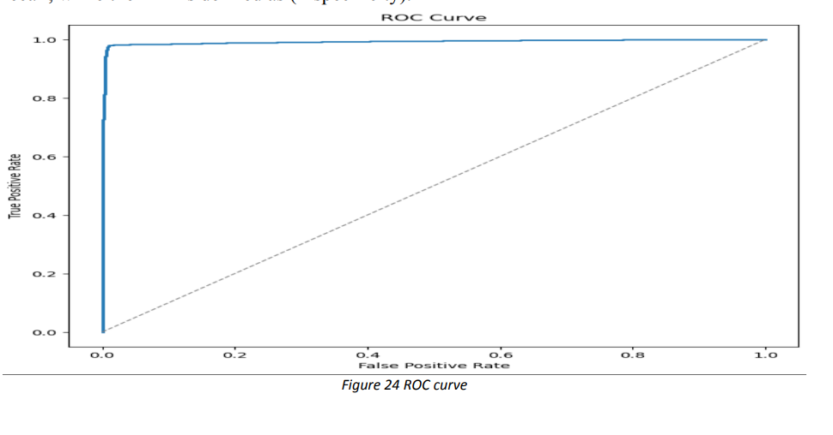
ROC curve for CatBoost
CatBoost classifier's ROC curve performs excellently in distinguishing crashes involving 2 or more vehicles.
AUC score of 0.9948 confirms the classifier’s strong discrimination ability between positive and negative instances.
CatBoost classifier outperforms a random classifier (gray dashed line) with its ROC curve positioned in the top-left corner.
These results validate the effectiveness of the CatBoost algorithm for predicting multi-vehicle crashes in the crash_df dataset.
ROC curve and AUC analysis provide valuable insights into the classifier's performance in binary classification tasks.

Slide 11
XGBoost for 2 Variables
The XGBoost model achieves an accuracy of 0.9598, correctly classifying 95.98% of instances in the testing set.
The AUC score is calculated as 0.9820, indicating strong performance in distinguishing between crashes involving 2 or more vehicles and those that do not.
The high AUC score suggests that the XGBoost model is accurate and reliable in its predictions.
The ROC curve, a widely used evaluation metric for binary classification models, is plotted to visualize the model's performance.
The ROC curve illustrates the trade-off between the sensitivity (true positive rate) and specificity (true negative rate) of the classifier at different threshold values.
The plot helps assess the model's ability to classify positive and negative instances across different decision thresholds correctly.
Overall, the XGBoost model demonstrates strong performance and provides valuable insights for predicting multiple-vehicle crashes.
The high accuracy, AUC score, and ROC curve analysis highlight the effectiveness of the XGBoost model in this binary classification task.

Slide 12
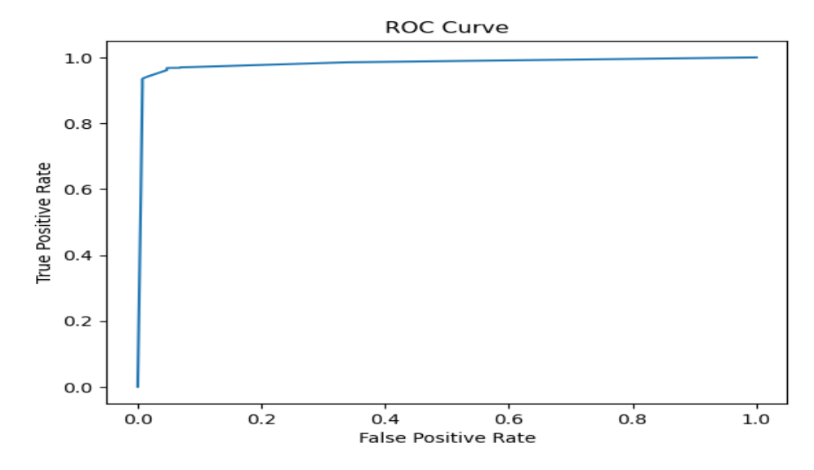
ROC curve for XGBoost
XGBoost model shows excellent performance in distinguishing between positive and negative instances, as seen from the smooth upward slope of the ROC curve.
AUC score of 0.9820 indicates strong model performance, with higher values suggesting better classification accuracy.
The shape of the ROC curve and high AUC score validate the reliability and effectiveness of the XGBoost model in predicting the number of vehicles involved in crashes.
XGBoost model provides accurate and reliable predictions, making it a valuable tool for classifying crashes based on the number of vehicles involved.
These findings underscore the efficacy of the XGBoost algorithm in accurately differentiating crashes based on the number of vehicles involved.

Slide 13
Machine Learning Algorithms utilized:
Decision Tree
Random Forest Tree
Gradient Boosting

Slide 14
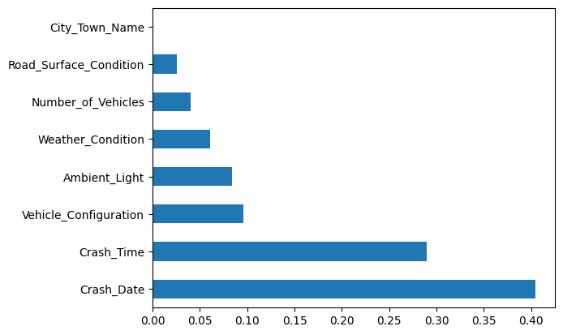
Decision Tree
The bar chart shows feature importance scores for the variables Crash_Date and City_Town_name in the Decision Tree model.
Crash_Date has a high importance score of approximately 0.40, indicating its significant impact on the model's predictions.
City_Town_name has a low importance score close to 0.0, suggesting minimal influence on the model's predictions.

Slide 15
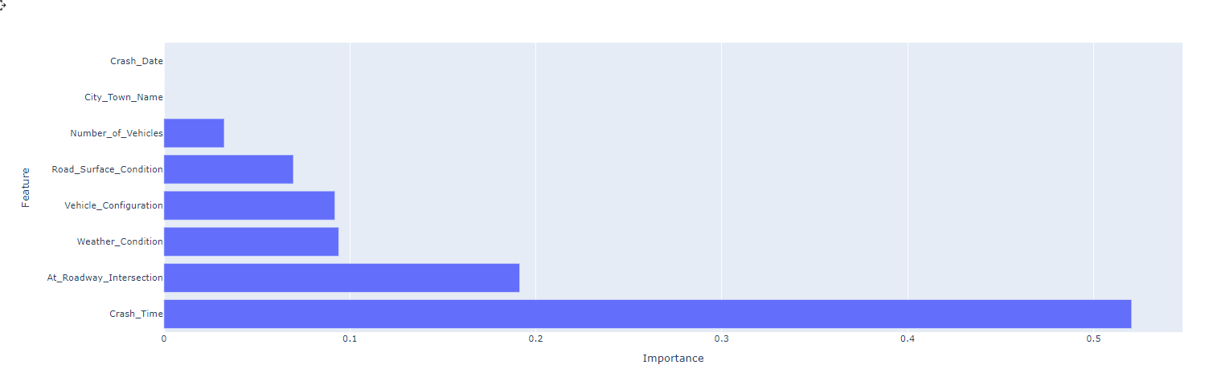
Random Forest Tree
The importance graph shows that Crash_Time has a higher importance score, while Crash_Date has an importance score of 0.0 in the Random Forest Tree model.
The importance score indicates the relative significance of each feature in making predictions.
Crash_Time is identified as the most important feature, suggesting that the time of the crash plays a crucial role in the model's predictions.

Slide 16
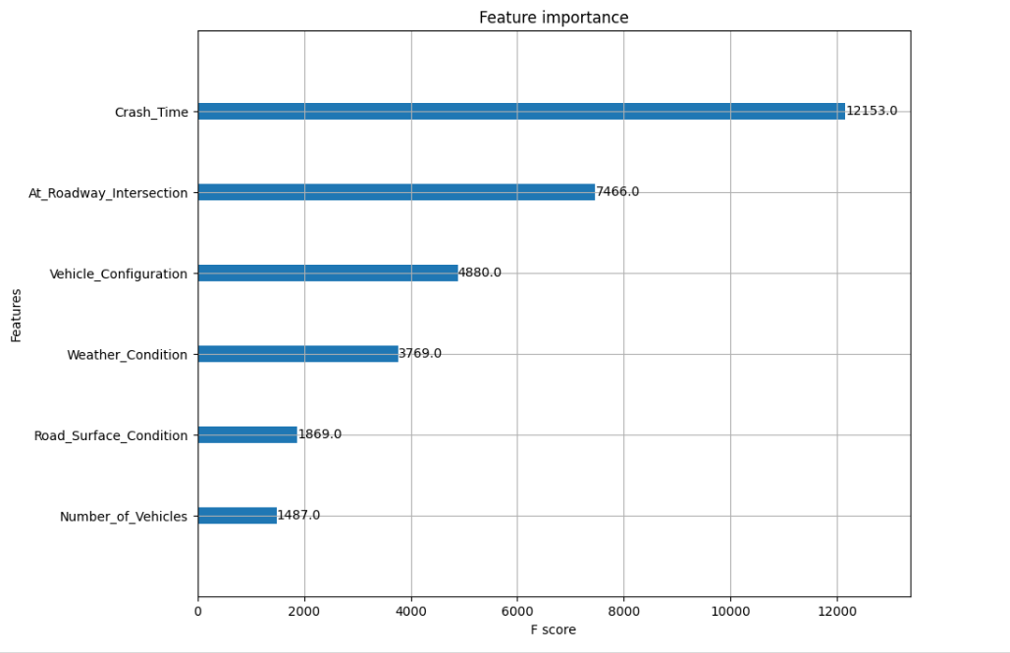
Gradient Boosting
Gradient Boosting Machine (GBM) is an ensemble learning method that builds multiple decision trees sequentially.
By combining numerous weak learners, GBM reduces bias and variance, resulting in generally better performance compared to individual Decision Trees or Random Forests.
However, training a GBM model on large datasets can be slower and require more memory due to the sequential nature of tree building.
Here, Crash_time is at 12153.0 importance and lowest is of Nmber_of_vehicles at 1487.0

Slide 17
Conclusion and Recommendations
In conclusion, we recommend using the CatBoost or XGBoost model for predicting whether a crash involves 2 or more vehicles due to their high accuracy and AUC scores.
However, we also acknowledge that the Logistic Regression and Random Forest models performed well and may be suitable for certain applications.
Overall, our findings suggest that machine learning models can be effective tools for predicting the likelihood of a crash involving multiple vehicles and can be useful in improving road safety

Slide 18
Thank You!

